Slide 1


Kwabena B. Sapong
WELCOME
ABOUT ME
CONTACT ME
SIGN UP / SIGN IN
Hello
I Am An Engineer
Software Engineer – Full Stack
Contact me

Slide 2
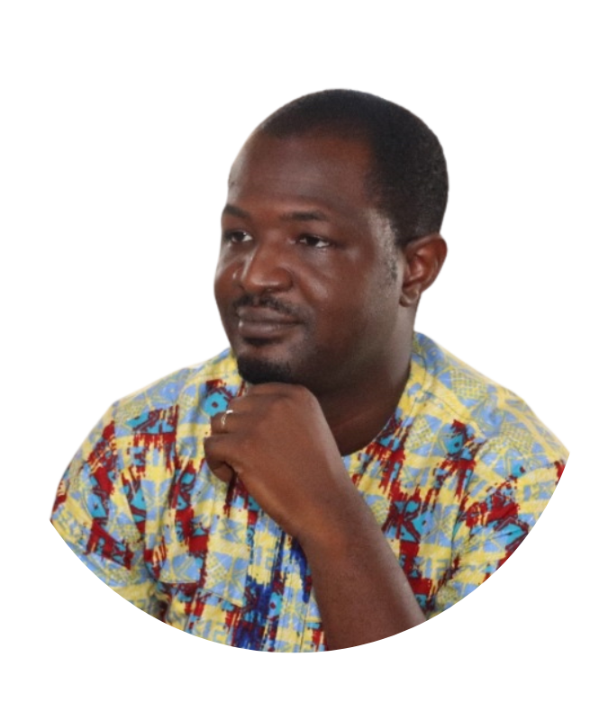

Kwabena B. Sapong
WELCOME
ABOUT ME
CONTACT ME
SIGN UP / SIGN IN
Hello,
My Name Is
Kwabena B. Sapong
I am a dynamic and innovative professional with more than 10 years of invaluable hands-on experience in the traditional engineering sector. Now, training to be a full stack software engineer with Zuri Academy.
Skills
Corel Draw
Adobe Illustrator
HTML / CSS / JavaScript
Python / C
Linux / Vagrant
Git & Github
Priorities
Corel Draw
Adobe Illustrator
HTML / CSS / JavaScript
Python / C
Linux / Vagrant
Git & Github
Hobbies
Tinkering
Reading
Tennis
Gaming
Net Surfing
Movies
About Me

Slide 3
Kwabena B. Sapong
WELCOME
ABOUT ME
CONTACT ME
SIGN UP / SIGN IN
ENTER NAME :
E-MAIL :
ENTER YOUR MESSAGES :
Contact
Get In Touch
Address : 123 Anywhere St., Any City, ST 12345
E-mail : hello@reallygreatsite.com
Phone : +123-456-7890
@reallygreatsite
www.reallygreatsite.com

Slide 4
Kwabena B. Sapong
WELCOME
ABOUT ME
CONTACT ME
SIGN UP / SIGN IN
ENTER NAME :
E-MAIL :
ENTER NAME :
ENTER NAME :
ENTER NAME :
Get In Touch
@reallygreatsite
www.reallygreatsite.com
ENTER NAME :

